Slide 1
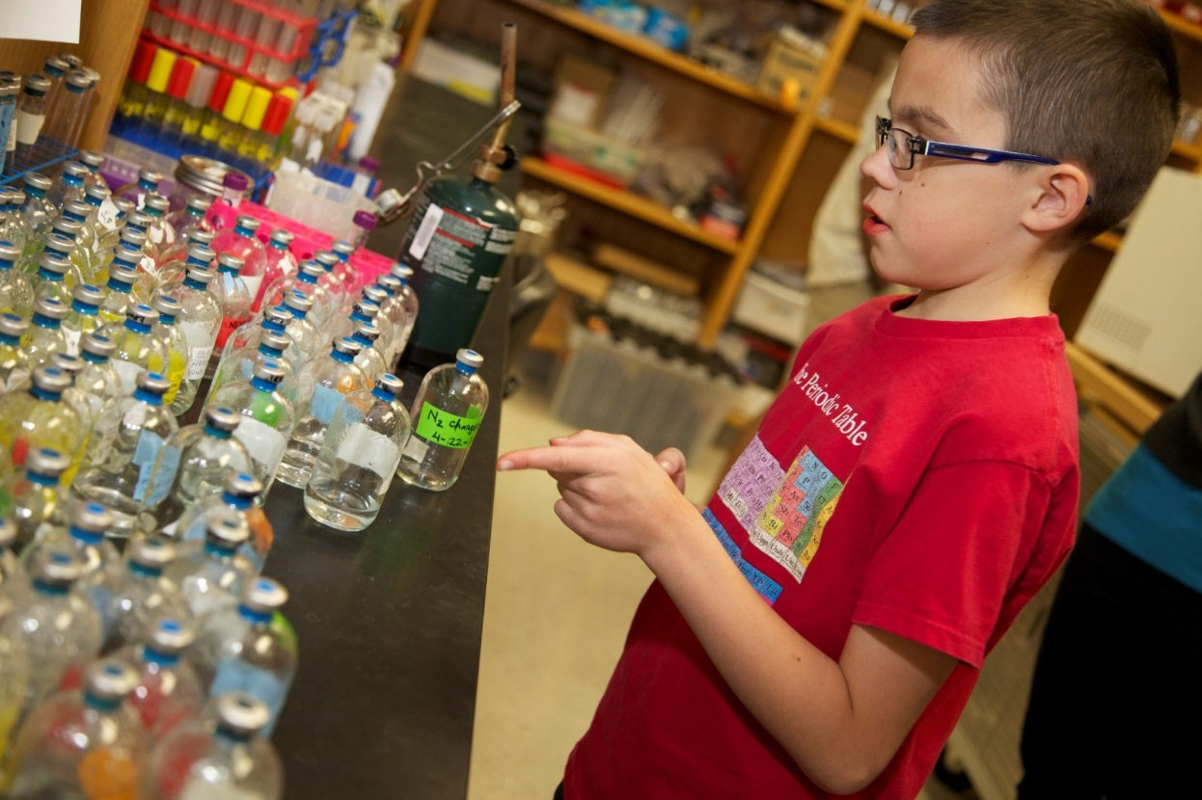

The Power of Science
Notes:
So Justin highlighted some of DRI’s notable contributions to the global research community and the positive implications of new scientific discoveries for not only Nevada, but the rest of the world. But who will continue this work once faculty member like Richard decide to retire from his respective field?
Who will take his place? Will Nevada’s youth be poised to pick up where he left off? And maybe an even more important question to ask is, would they even be interested in doing so?

Slide 2

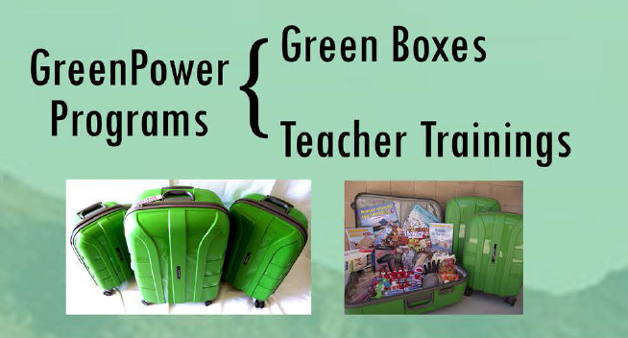
DRI’s Connection to K-12 Education
GreenPower Mission
To support Nevada's PreK-12 educators in science-based, environmental education by providing the tools, resources, and knowledge they need, so all students acquire the knowledge and skills needed to work, live and contribute in our community.
GreenPower Vision
We aim to increase scientific knowledge and understanding of the earth's environment, promoting preservation of diverse ecosystems, advancing responsible resource management, and improving human health and welfare.
Notes:
We agree that the need to entice student interest in science, technology, engineering and math is greater than ever. And that’s where GreenPower comes in.
READ MISSION & VISION
Really what we want to do is translate all of the cutting edge research that is being conducted and 21st technology that is being developed here at DRI into tangible classroom tools and resources.
As you may have gathered from our mission statement, we do this in a unique way. The model we use targets the educators, as they are the experts in their respective field. Although we see great value in having professionals come into the classroom to talk about their work in our Storm Peak Laboratory, for example, we can reach more students by empowering the educator with both the background knowledge and confidence to disseminate that same information to their students.
We’ve created a two pronged program that aims to do just that.

Slide 3
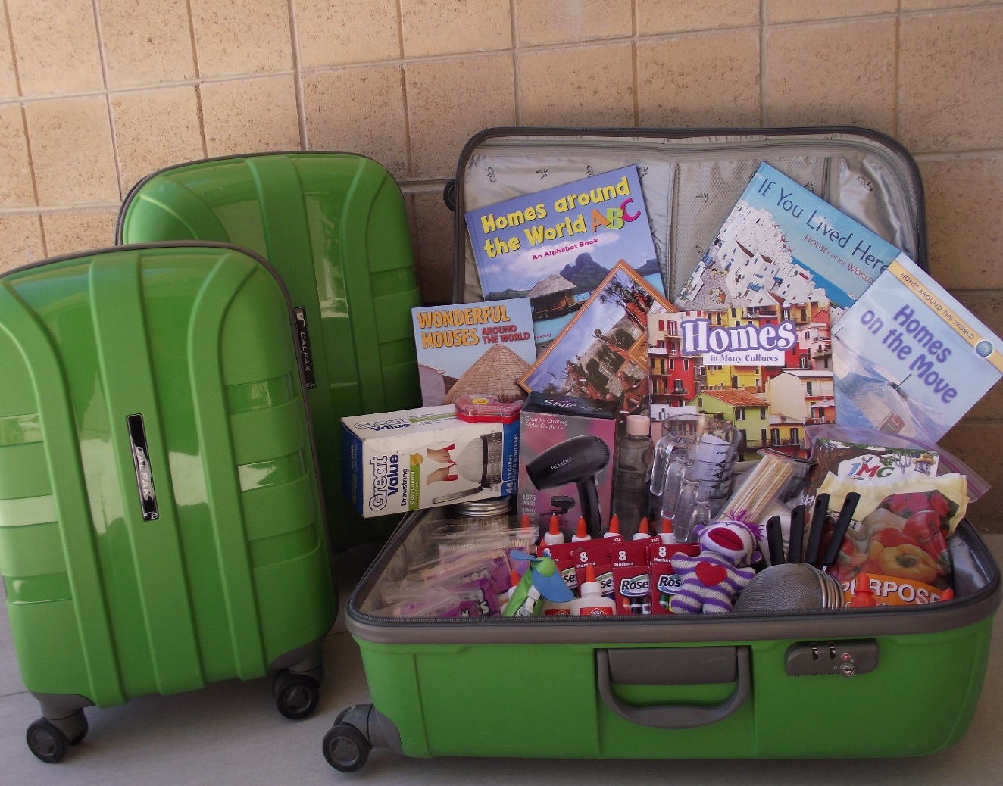
Green Boxes
Self-contained teaching kits provide educators with hands-on science experiments.
Standards-based lessons are designed to enhance student literacy in various STEM subject areas.
Aligned with Next Generation Science Standards
FREE of cost to any educator in Nevada!
Notes:
BULLET 1: Our Green Boxes include active learning materials that engage students directly with hands-on projects and experiences which are meant to build critical thinking and problem solving skills. These kits are designed to drive student inquiry and excitement for STEM by exposing them to subject matter and specialized equipment they might otherwise not have access to.
BULLET 2: Each Green Box includes about a unit’s worth of lessons, which equates to about 1 – 2 weeks’ worth of activities. We include everything the teacher will need to conduct the labs, from multimeters, miniature wind turbines, and salinity meters TO paper, pencils, glue etc. The unfortunate reality is most teachers, especially those at the elementary level, have to dig into their own pockets if they would want to use certain materials in the classroom.

Slide 4
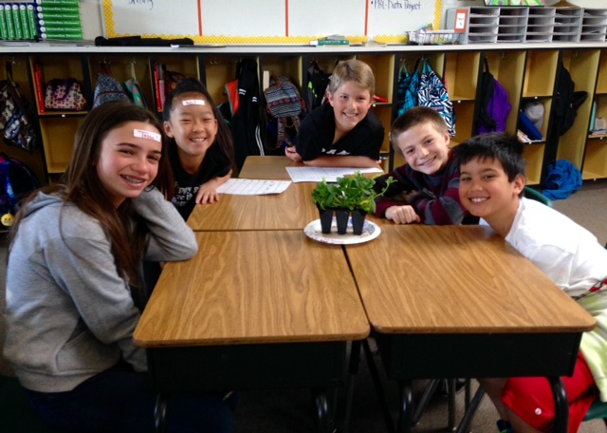
Artful Architecture Green Box
Conservatory Construction - Performance Expectations:
3-5-ETS1-1. Define a simple design problem reflecting a need or a want that includes specified criteria for success and constraints on materials, time, or cost.
3-5-ETS1-2. Generate and compare multiple possible solutions to a problem based on how well each is likely to meet the criteria and constraints of the problem.
3-5-ETS1-3. Plan and carry out fair tests in which variables are controlled and failure points are considered to identify aspects of a model or prototype that can be improved
Sepulveda Elementary School – 5th grade classroom
Notes:
BULLET 1: Our Green Boxes include active learning materials that engage students directly with hands-on projects and experiences which are meant to build critical thinking and problem solving skills. These kits are designed to drive student inquiry and excitement for STEM by exposing them to subject matter and specialized equipment they might otherwise not have access to.
BULLET 2: Each Green Box includes about a unit’s worth of lessons, which equates to about 1 – 2 weeks’ worth of activities. We include everything the teacher will need to conduct the labs, from multimeters, miniature wind turbines, and salinity meters TO paper, pencils, glue etc. The unfortunate reality is most teachers, especially those at the elementary level, have to dig into their own pockets if they would want to use certain materials in the classroom.

Slide 5
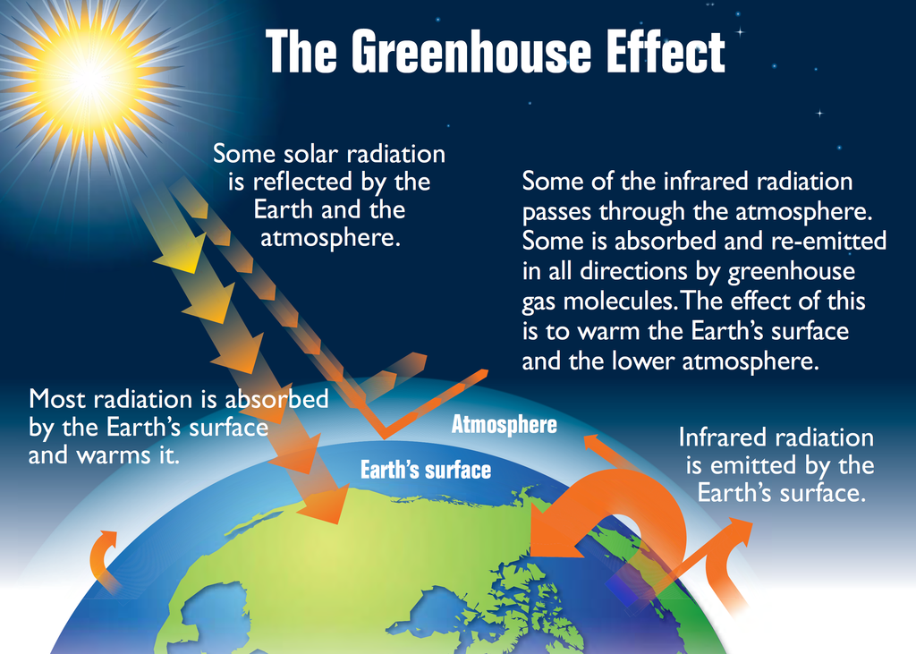
The Greenhouse Effect
The Greenhouse Effect
The Earth gets energy from the sun in the form of sunlight. The Earth's surface absorbs some of this energy and heats up. That's why the surface of a road can feel hot even after the sun has gone down—because it has absorbed a lot of energy from the sun. The Earth cools down by giving off a different form of energy, called infrared radiation. But before all this radiation can escape to outer space, greenhouse gases in the atmosphere absorb some of it, which makes the atmosphere warmer. As the atmosphere gets warmer, it makes the Earth's surface warmer, too.
Notes:
BULLET 1: Our Green Boxes include active learning materials that engage students directly with hands-on projects and experiences which are meant to build critical thinking and problem solving skills. These kits are designed to drive student inquiry and excitement for STEM by exposing them to subject matter and specialized equipment they might otherwise not have access to.
BULLET 2: Each Green Box includes about a unit’s worth of lessons, which equates to about 1 – 2 weeks’ worth of activities. We include everything the teacher will need to conduct the labs, from multimeters, miniature wind turbines, and salinity meters TO paper, pencils, glue etc. The unfortunate reality is most teachers, especially those at the elementary level, have to dig into their own pockets if they would want to use certain materials in the classroom.

Slide 6
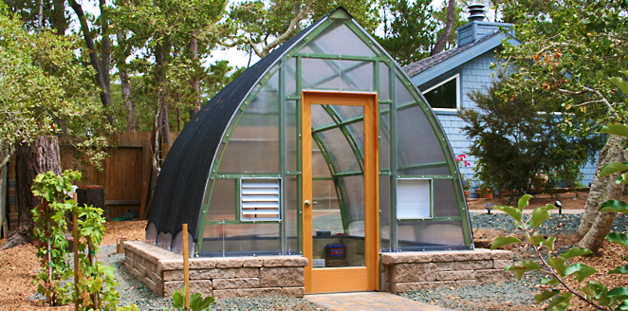
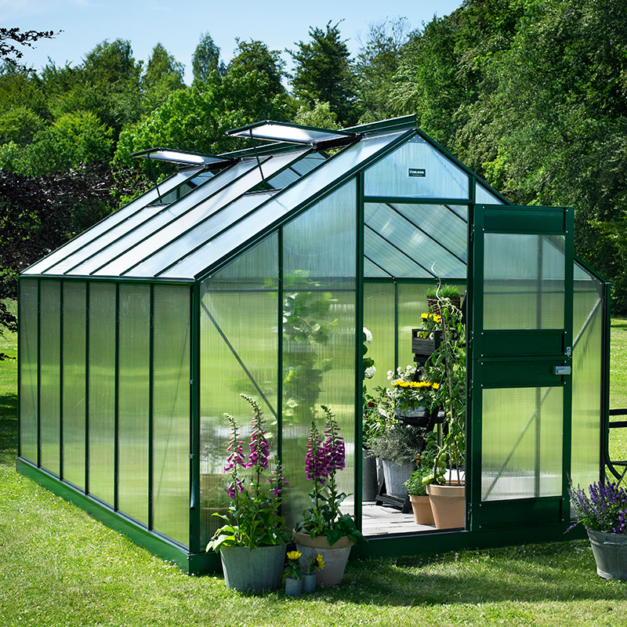
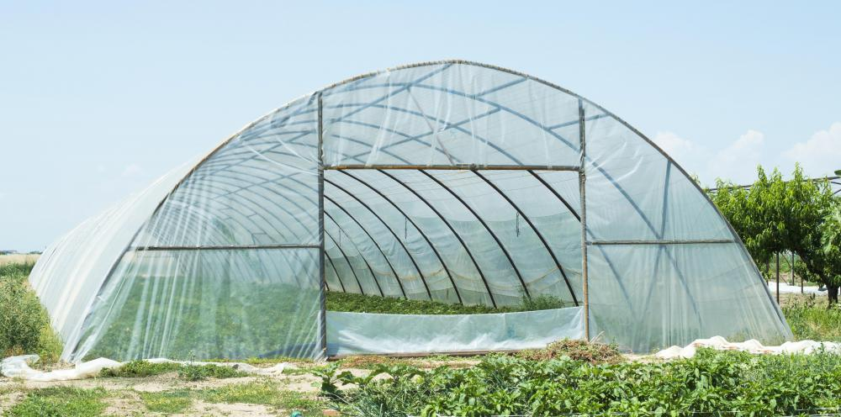
Greenhouses
Notes:
BULLET 1: Our Green Boxes include active learning materials that engage students directly with hands-on projects and experiences which are meant to build critical thinking and problem solving skills. These kits are designed to drive student inquiry and excitement for STEM by exposing them to subject matter and specialized equipment they might otherwise not have access to.
BULLET 2: Each Green Box includes about a unit’s worth of lessons, which equates to about 1 – 2 weeks’ worth of activities. We include everything the teacher will need to conduct the labs, from multimeters, miniature wind turbines, and salinity meters TO paper, pencils, glue etc. The unfortunate reality is most teachers, especially those at the elementary level, have to dig into their own pockets if they would want to use certain materials in the classroom.

Slide 7
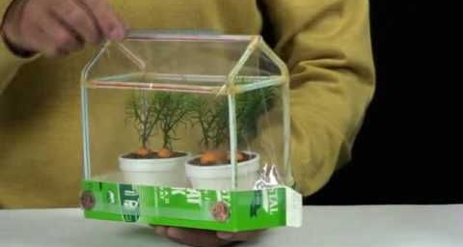
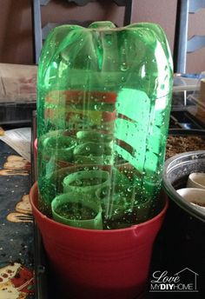
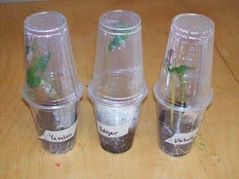
Conservatory Construction
Directions:
Within your group, take a few minutes to design your greenhouse. Ensure your growing area (egg carton) will be able to fit inside.
Assess the materials available for construction:
  Cardstock
  Tape
  Plastic wrap
  Recyclables
Construct your greenhouse/conservatory in the defined time constraints.
Notes:
BULLET 1: Our Green Boxes include active learning materials that engage students directly with hands-on projects and experiences which are meant to build critical thinking and problem solving skills. These kits are designed to drive student inquiry and excitement for STEM by exposing them to subject matter and specialized equipment they might otherwise not have access to.
BULLET 2: Each Green Box includes about a unit’s worth of lessons, which equates to about 1 – 2 weeks’ worth of activities. We include everything the teacher will need to conduct the labs, from multimeters, miniature wind turbines, and salinity meters TO paper, pencils, glue etc. The unfortunate reality is most teachers, especially those at the elementary level, have to dig into their own pockets if they would want to use certain materials in the classroom.

